Slide 1
2021 MOD PR Group
Aggregated Residual Transformations for Deep Neural Networks
방인서

Slide 2
Abstract
Width 보다 Cardinality를 늘리는 것이 효율적이다 !

Slide 3
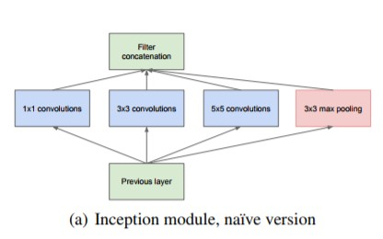
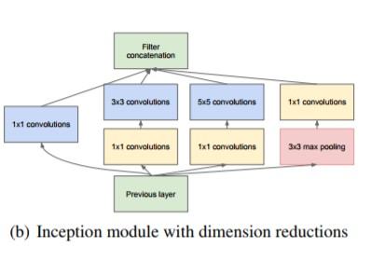
Introduction
“Split – Transform – Merger”
Inception

Slide 4
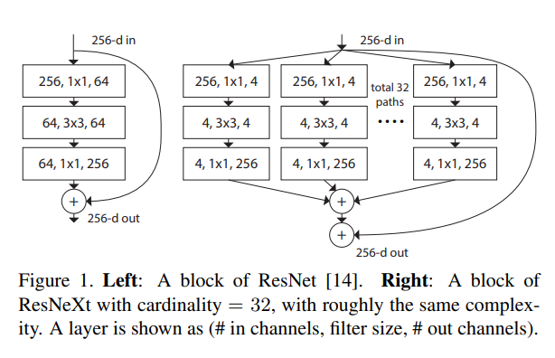
Introduction
Cardinality : the size of the set of transformation
Resnext block

Slide 5
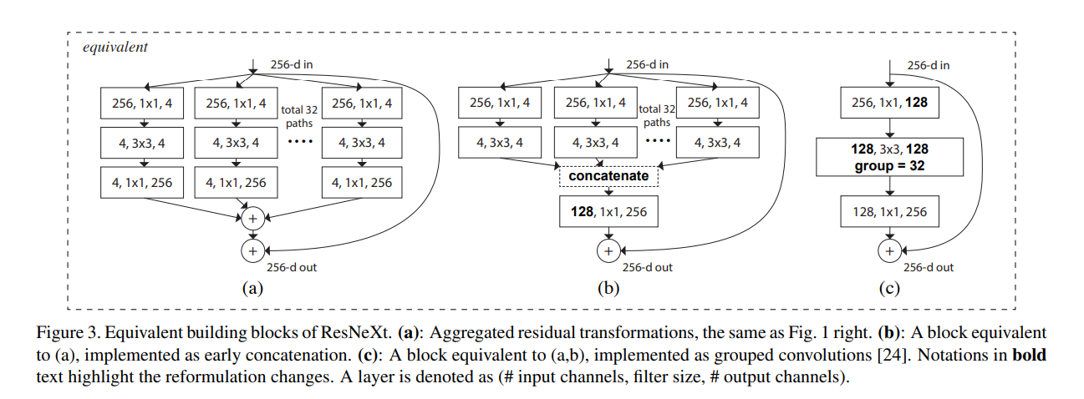
Introduction

Slide 6
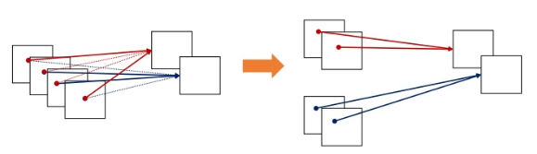
Introduction
Group convolution

Slide 7
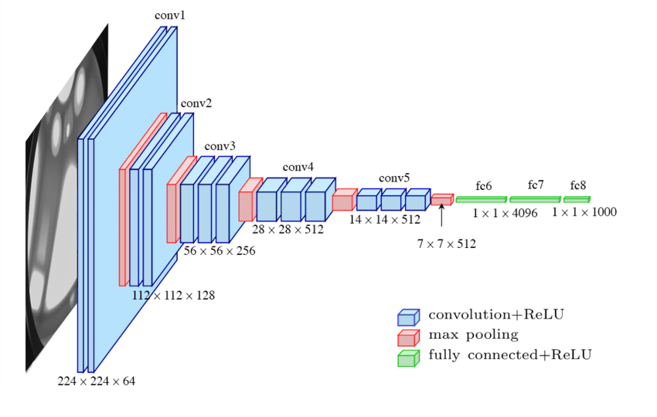
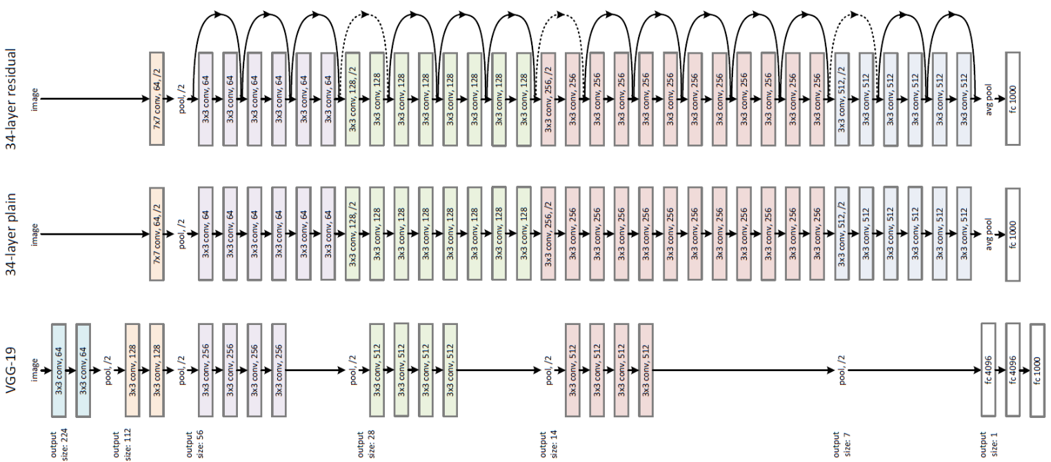
Method
VGG16
Resnet

Slide 8
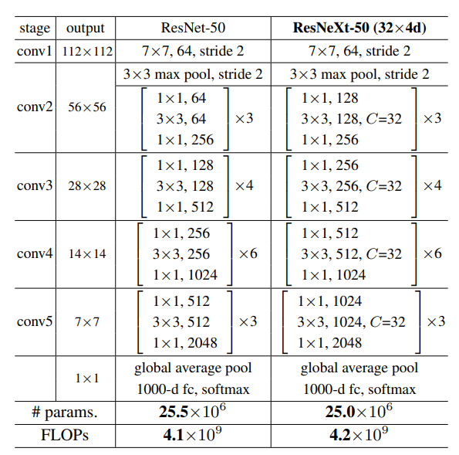
Method

Slide 9
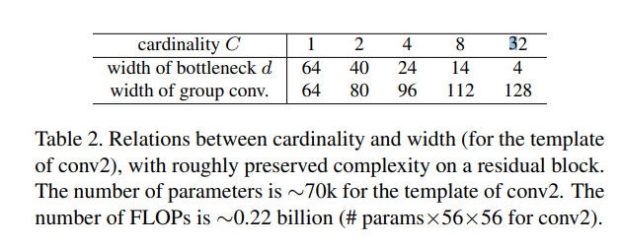

Method

Slide 10
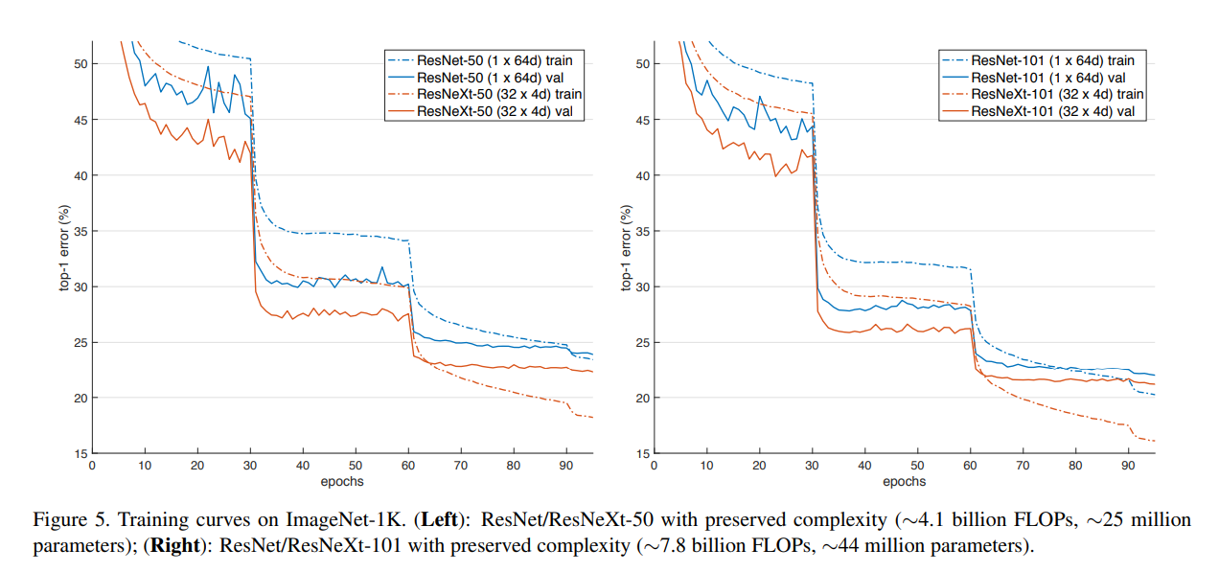
Experiment

Slide 11
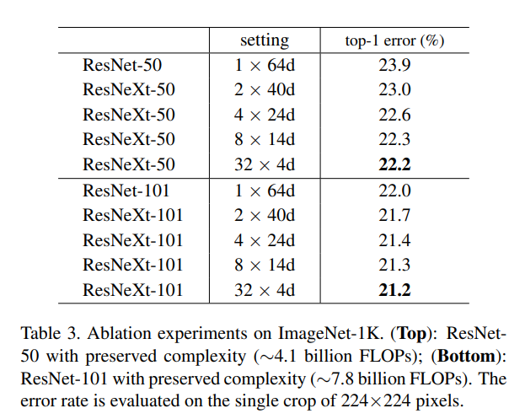
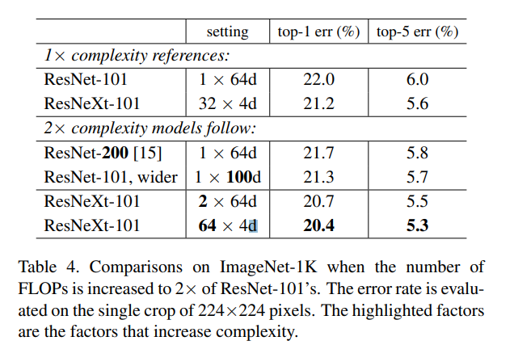
Experiment

Slide 12
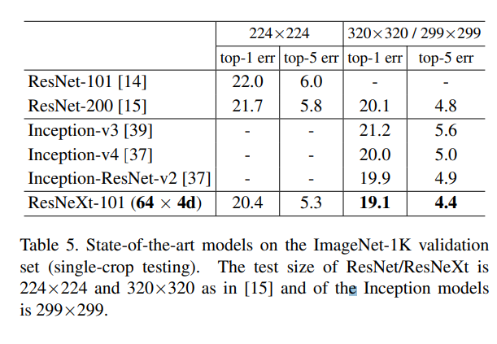
Experiment

Slide 13
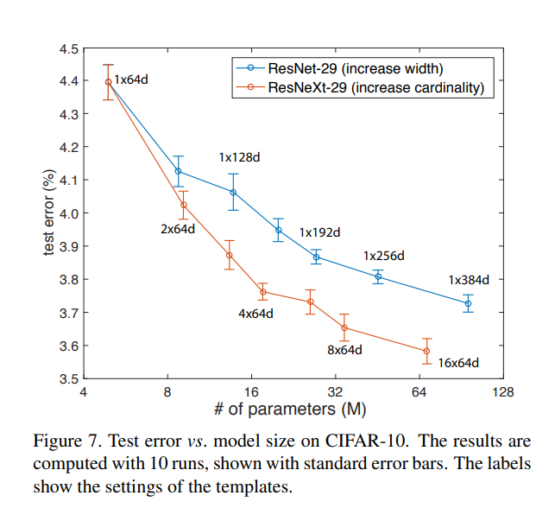
Experiment

Slide 14
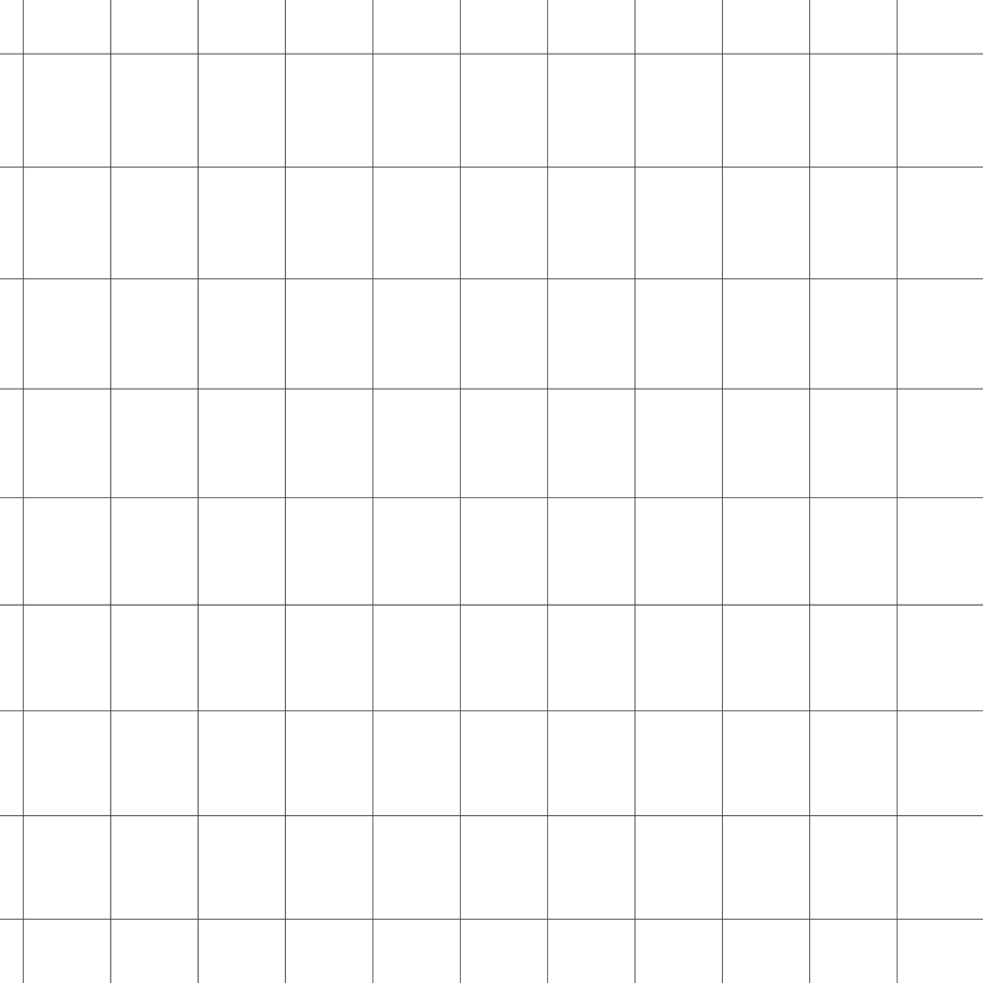
Thank you

